Slide 1
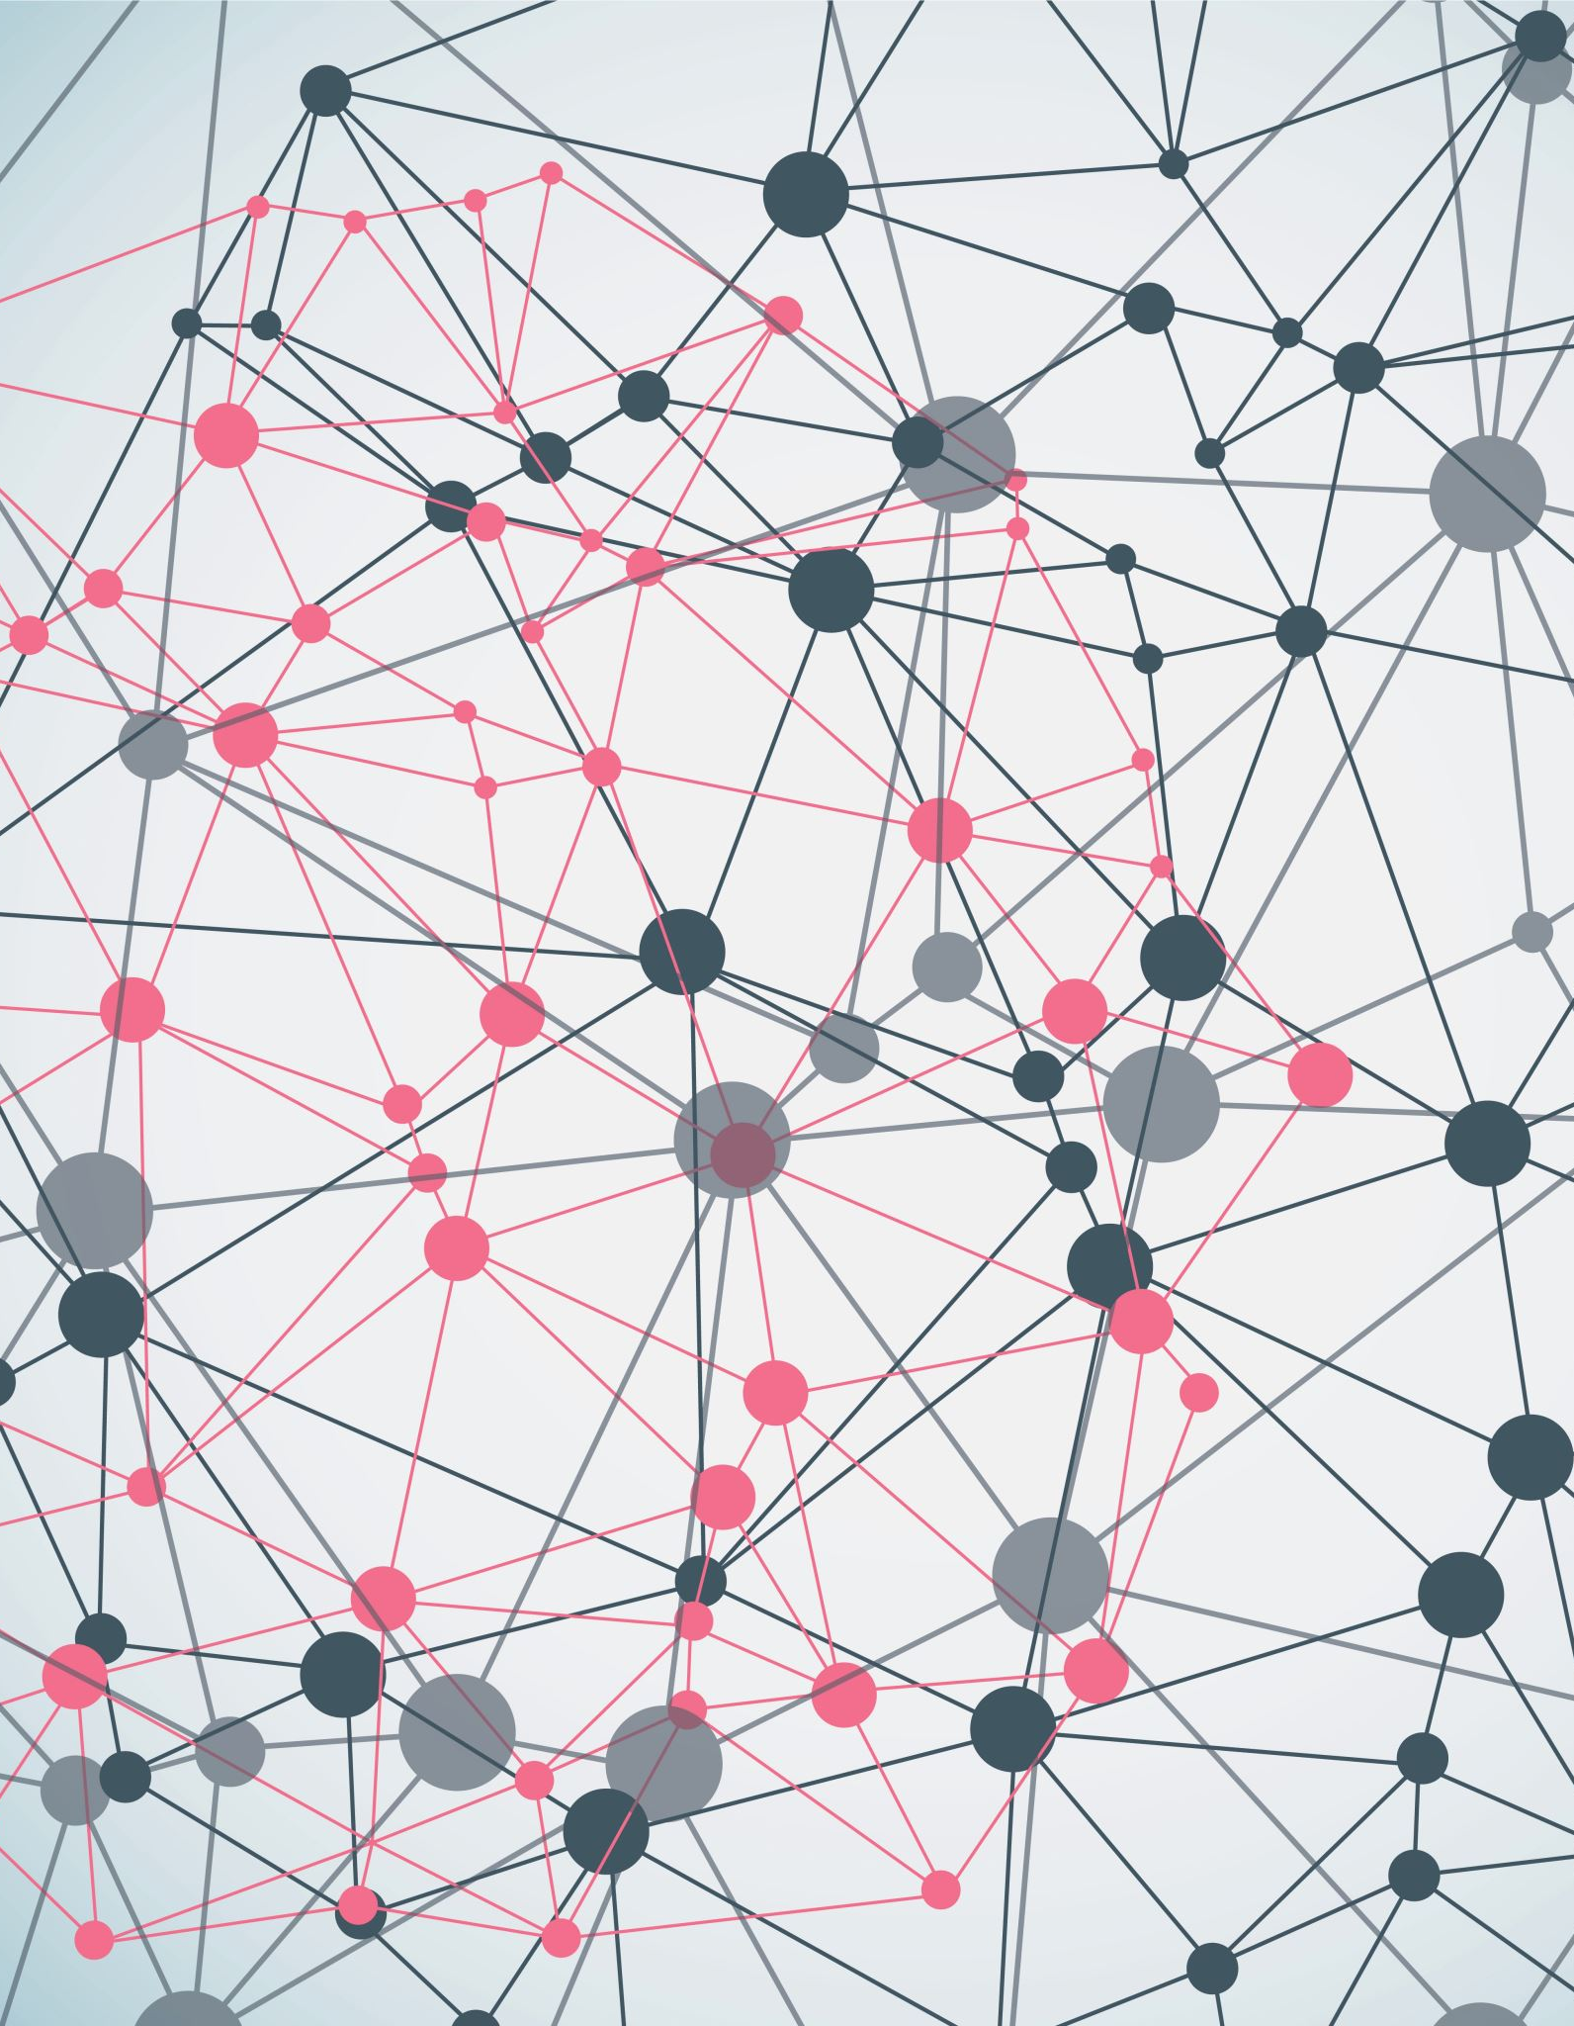
Spark Streaming

Slide 2
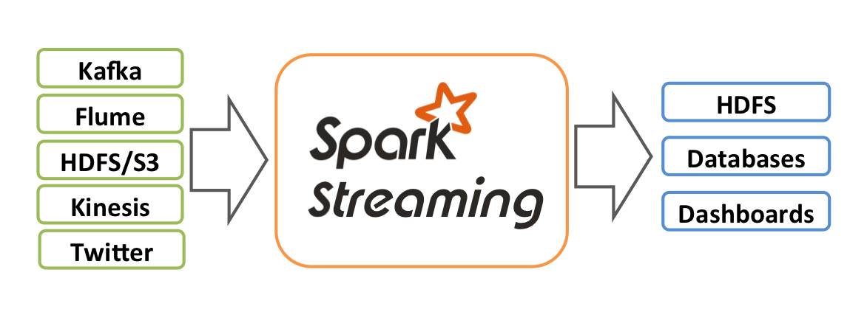

Slide 3
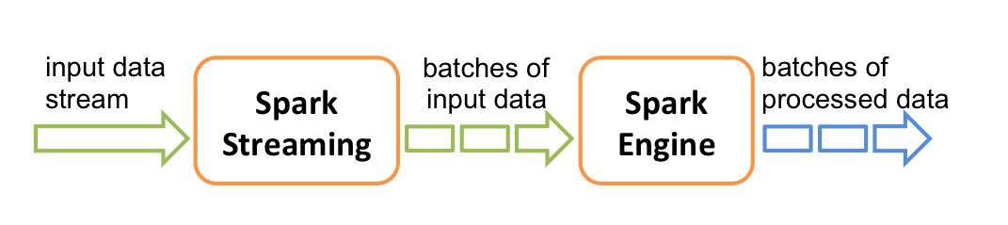
te the final stream of results in batches.

Slide 4

Discretized Streams (DStreams)
Discretized Stream or DStream is the basic abstraction provided by Spark Streaming. It represents a continuous stream of data, either the input data stream received from source, or the processed data stream generated by transforming the input stream. Internally, a DStream is represented by a continuous series of RDDs, which is Spark’s abstraction of an immutable, distributed dataset (see Spark Programming Guide for more details). Each RDD in a DStream contains data from a certain interval, as shown in the following figure.

Slide 5
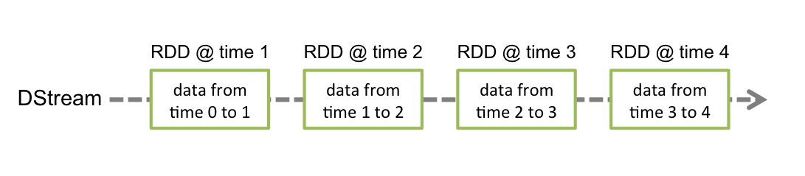
figure.

Slide 6
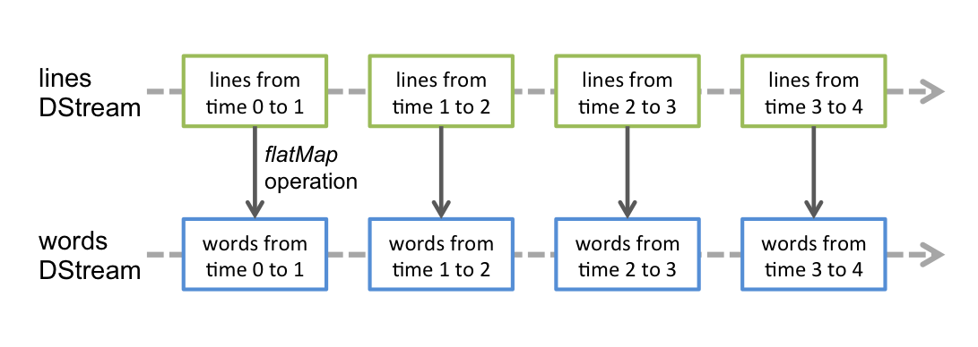
figure.

